Slide 1

Blockchain

Slide 2
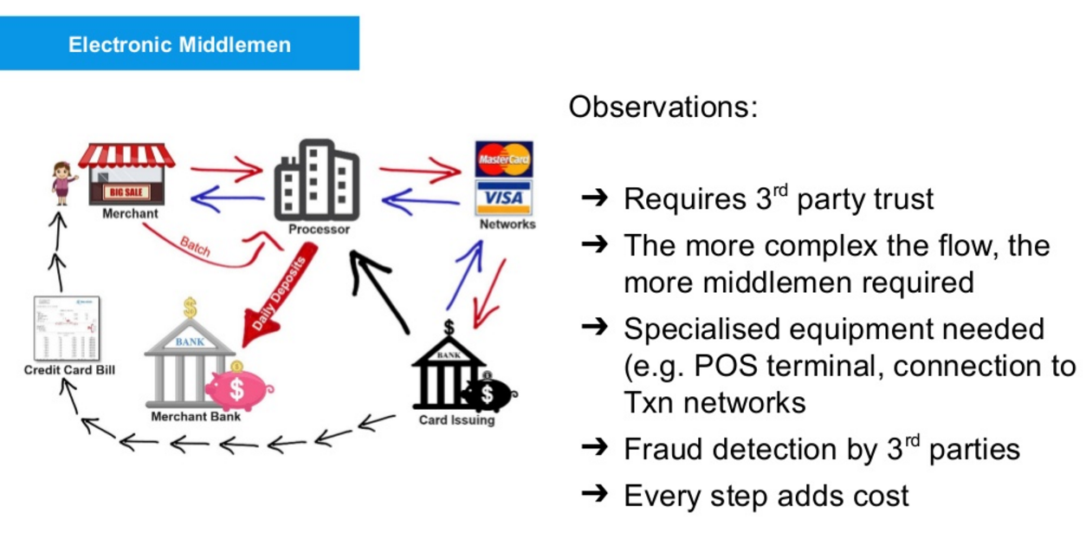
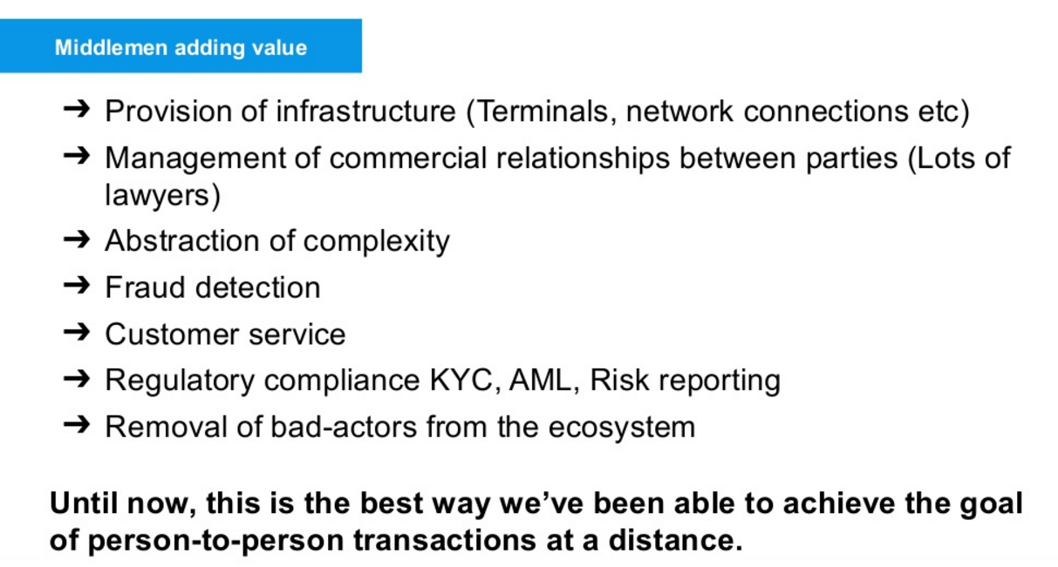
Understating Current System

Slide 3
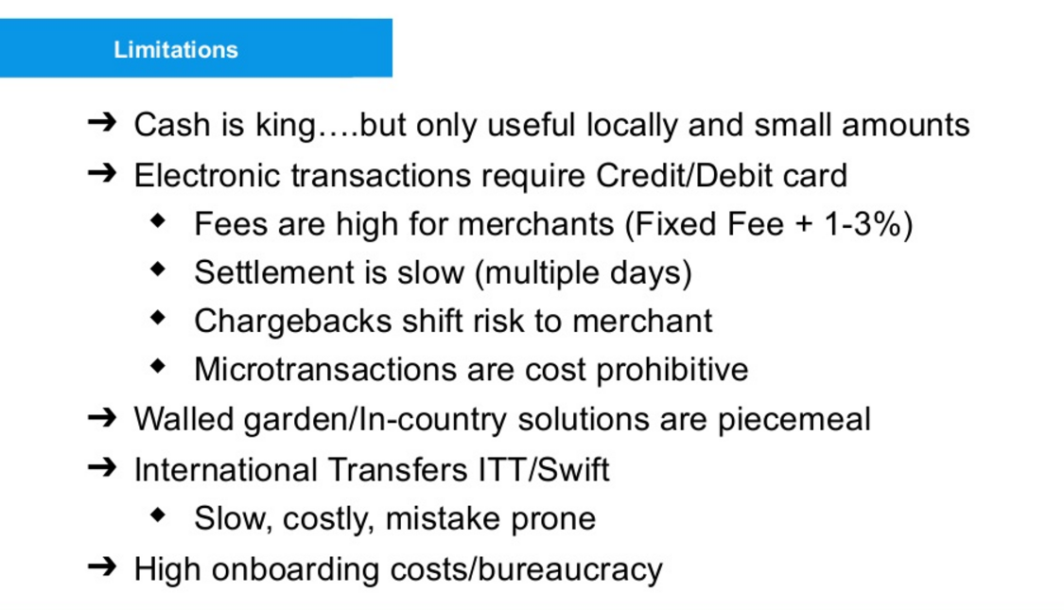
Understating Current System

Slide 4
Double Spending problem
DEFINITION of 'Double-Spending‘
The risk that a digital currency can be spent twice.
Double-spending is a problem unique to digital currencies because digital information can be reproduced relatively easily.
Physical currencies do not have this issue because they cannot be easily replicated, and the parties involved in a transaction can immediately verify the bona fides of the physical currency.
With digital currency, there is a risk that the holder could make a copy of the digital token and send it to a merchant or another party while retaining the original.
This was a concern initially with Bitcoin, the most popular digital currency or "cryptocurrency," since it is a decentralized currency with no central agency to verify that it is spent only once.
Ways to ‘Double Spending’ attack-
51% attack
Race Attack
Finney Attack
Vector 76 Attack (Race attack + Finney Attack)/One confirmation attack
Alternative Transaction Attack

Slide 5
Blockchain | What is Blockchain
The blockchain is an undeniably ingenious invention – the brainchild of a person or group of people known by the pseudonym, Satoshi Nakamoto. By allowing digital information to be distributed but not copied, blockchain technology created the backbone of a new type of internet.
Often described as the technology that underpins the Bitcoin network, a blockchain data structure has a shared, replicated ledger comprised of digitally recorded and unchangeable data in packages called blocks.
The blockchain provides Bitcoin’s public ledger, an ordered and time-stamped record of transactions. This system is used to protect against double spending and modification of previous transaction records.
The blockchain is an incorruptible digital ledger of economic transactions that can be programmed to record not just financial transactions but virtually everything of value.
Private institutions like banks realized that they could use the core idea of blockchain as a Distributed Ledger Technology (DLT).
A blockchain is a way to implement a distributed ledger, but not all distributed ledgers necessarily employ blockchains.

Slide 6
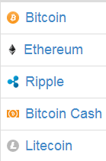
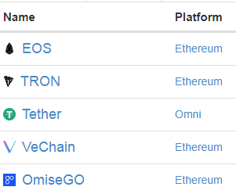
Blockchain | What is Blockchain | Coin/Token
Blockchain
Ethereum
TenX
OMG
Neo
Red Pulse
Technology
Protocol
Token
Bitcoin
The main difference between altcoins/coins and tokens is in their structure; altcoins/coins are separate currencies with their own separate blockchain while tokens operate on top of a blockchain that facilitates the creation of decentralized applications.
Coins
Tokens

Slide 7
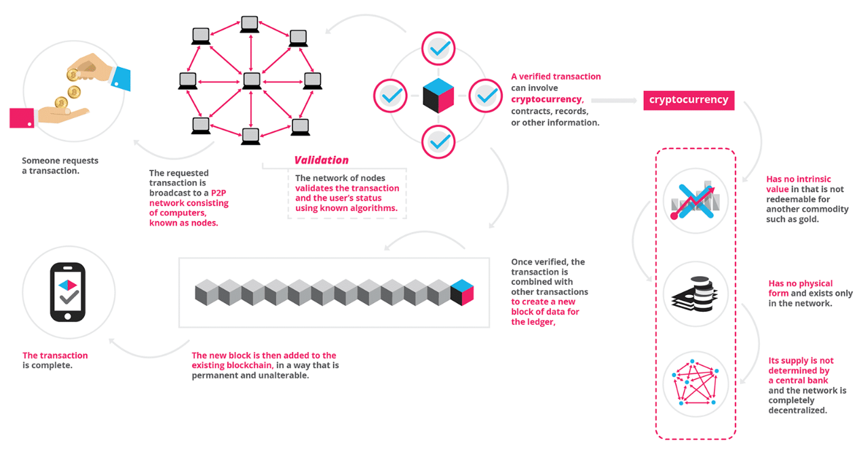
Blockchain | How it works

Slide 8
Blockchain | Key terms
Distributed
Permission less
Immutability
Consensus
Proof of Work
Encryption
Trust

Slide 9
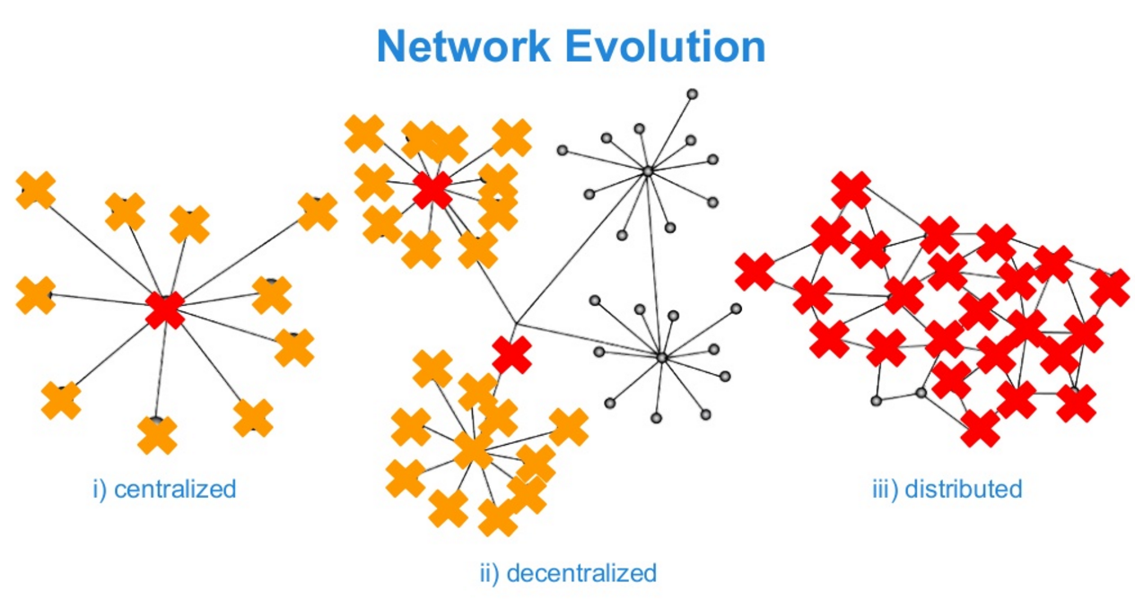
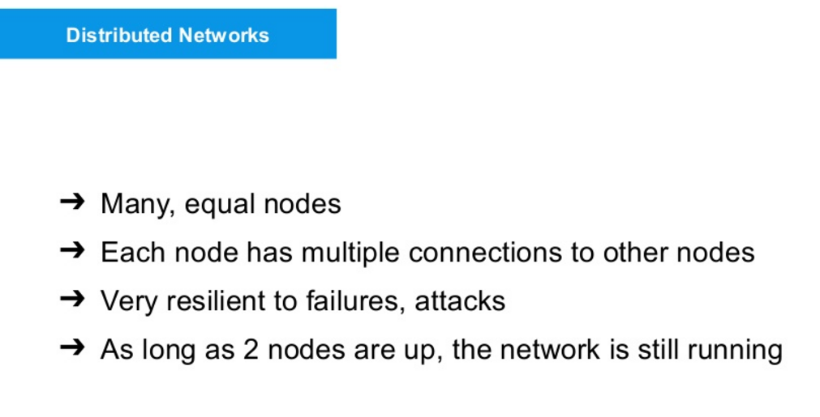
Blockchain | Key terms | Distributed

Slide 10
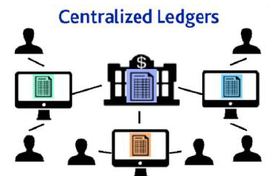
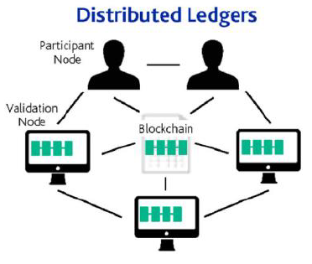
Blockchain | Key terms | Distributed
Centralized Ledger:
Maintained by a central party
Each institution maintains their own ledger - creates single point of failure
Reconciliation is required to make sure there are no failed transactions
Distributed Ledger:
Same copy of the ledger distributed to all nodes over peer to peer network
No single point of failure increasing resilience to outages and attacks
No reconciliation is required
No dependency on a central party

Slide 11
Blockchain | Key terms | Permission less
Anyone can participate, without permission. (1) Anyone can download the code and start running a public node on their local device, validating transactions in the network, thus participating in the consensus process – the process for determining what blocks get added to the chain and what the current state is. (2) Anyone in the world can send transactions through the network and expect to see them included in the blockchain if they are valid. (3) Anyone can read transaction on the public block explorer. Transactions are transparent, but anonymous/pseudonumous.
Examples: Bitcoin, Ethereum, Monero, Dash, Litecoin, Dodgecoin, etc.
Effects: (1) Potential to disrupt current business models through disintermediation. (2) No infrastructure costs: No need to maintain servers or system admins radically reduces the costs of creating and running decentralized applications (dApps).

Slide 12
Blockchain | Key terms | Immutability
In plain English, this word is used to denote something which can never be modified or changed.
In a blockchain, it refers to the global log of transactions, which is created by consensus between the chain’s participants. The basic notion is this: once a blockchain transaction has received a sufficient level of validation, some cryptography ensures that it can never be replaced or reversed. This marks blockchain as different from regular files or databases, in which information can be edited and deleted at will.

Slide 13
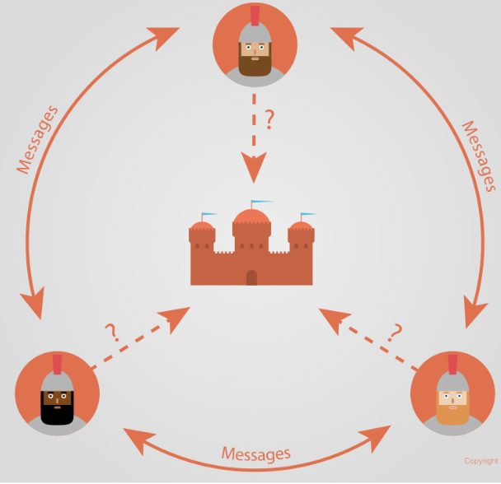
Blockchain | Key terms | Consensus
An identified problem in distributed computing, which is probably unsolvable but can nonetheless be mitigated, is how to reach consensus in a hierarchy-free, permission-less and failure-prone network.
Byzantine Generals' Problem:
Attack/Retreat

Slide 14
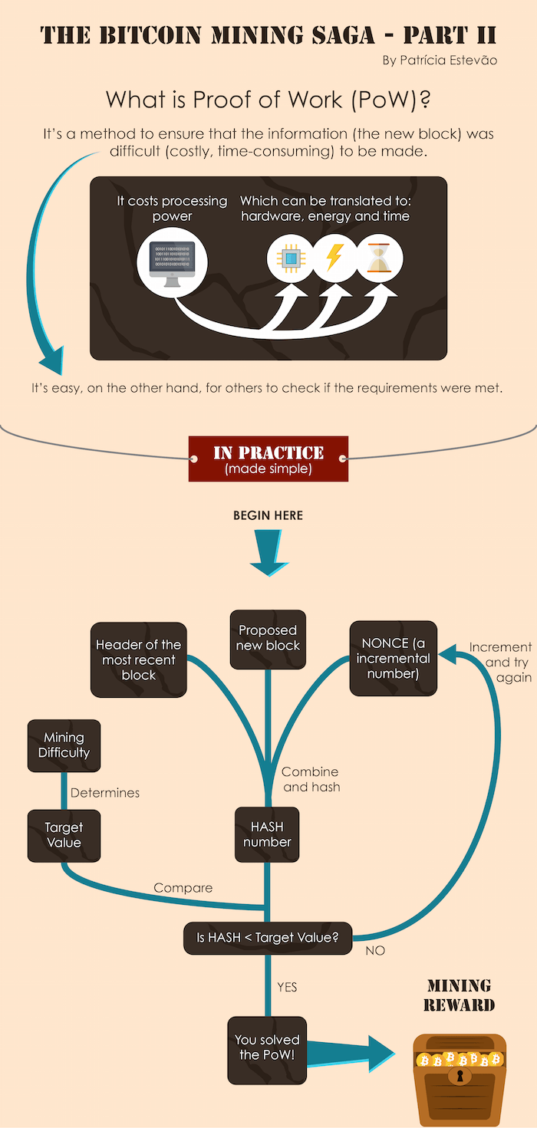
Blockchain | Key terms | Consensus | Proof of work

Slide 15
Blockchain | Key terms | Encryption
Each block of the blockchain is identified by:
the hash of its predecessor;
the root hash of its transactions merkle tree;
a nonce that solves the mining puzzle;
a hash of the above.
For a malicious node to remove or insert transactions, it would need to:
update the root hash of the containing block's Merkle tree;
update the nonce of the containing block;
update the hash of the containing block;
do the same for all subsequent blocks.
This is theoretically possible, but in practice requires the malicious nodes to harness more processing power than the honest nodes, hence the term 51%-attack.
Bitcoin uses SHA-256 encryption method.

Slide 16
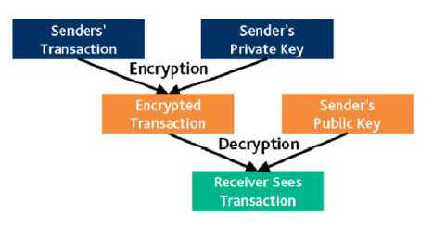
Blockchain | Key terms | Encryption
Transactions are secured thru public key cryptography
Private key is only known to sender and used to sign transactions
Sender’s Public key is visible to all over the network.
It allows to the network participants to verify the asset

Slide 17
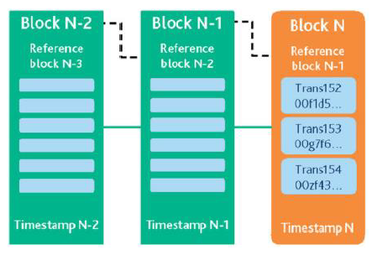
Blockchain |How are transactions grouped in a block?
All nodes will group recently verified transactions into a block and try to add it in the blockchain
Blocks with corrupt transactions will not be added to the network
New block will include a header with
Name of block
Timestamp of when it was created
Reference to previous block

Slide 18
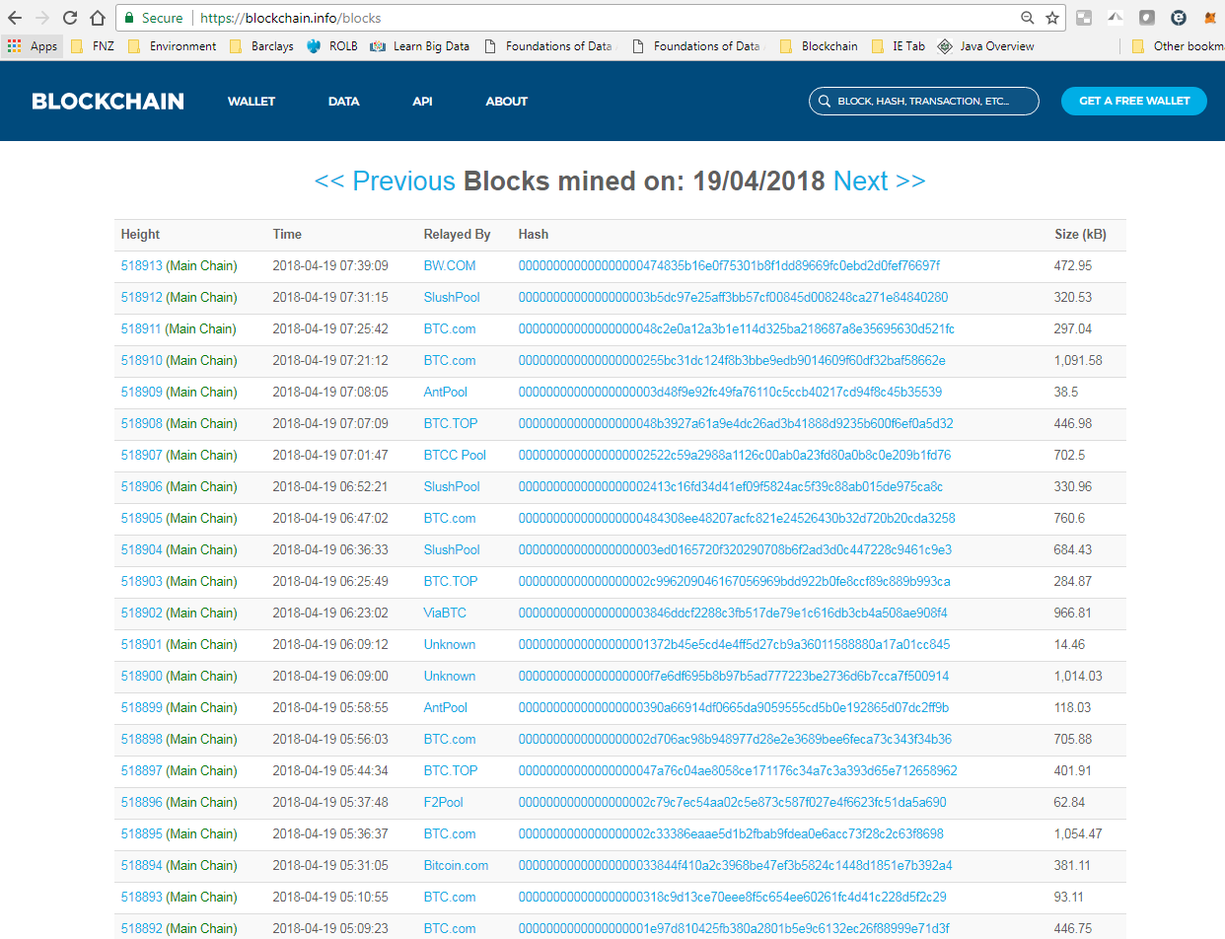
Blockchain | Live Bitcoin Blockchain

Slide 19
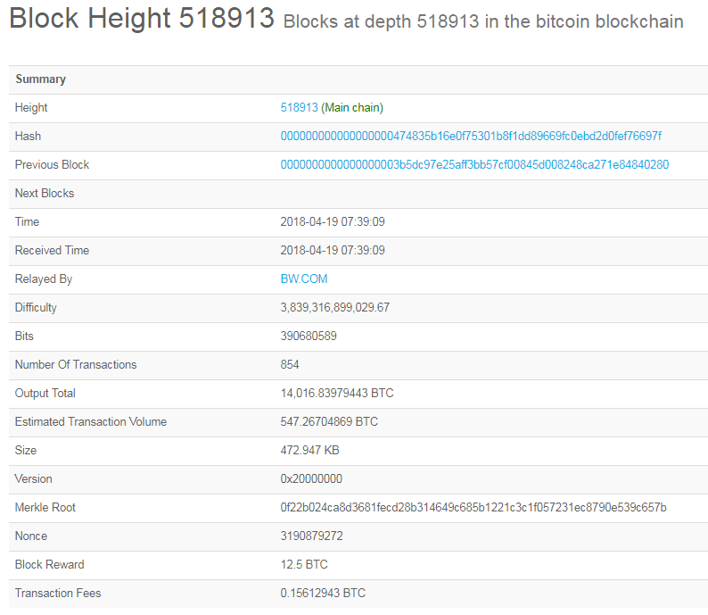
Blockchain | Live Bitcoin Block

Slide 20
Blockchain |Smart Contracts
Smart contracts help you exchange money, property, shares, or anything of value in a transparent, conflict-free way while avoiding the services of a middleman.
Smart contracts not only define the rules and penalties around an agreement in the same way that a traditional contract does, but also automatically enforce those obligations.
Smart contracts can:
Function as 'multi-signature' accounts, so that funds are spent only when a required percentage of people agree
Manage agreements between users, say, if one buys insurance from the other
Provide utility to other contracts (similar to how a software library works)
Store information about an application, such as domain registration information or membership records.

Slide 21
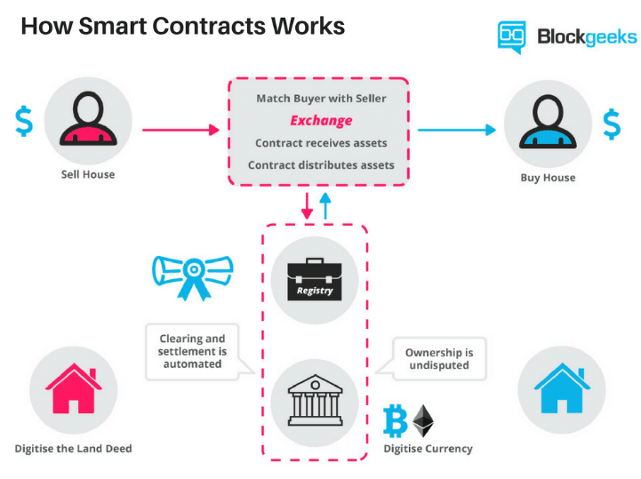
Blockchain |How Smart Contract works

Slide 22
Blockchain |Types of Blockchain | Public
A public blockchain as its name suggests is the blockchain of public, meaning a kind of blockchain which is-‘for the people, by the people and of the people’
Here no one is in charge and anyone can participate in reading/writing/auditing the blockchain. Another thing is that these types of blockchain are open and transparent hence anyone can review anything at a given point of time on a public blockchain.
But a natural question that comes to our mind is that when no one is in charge here then how the decisions are taken on these types of the blockchain. So the answer is that decision making happens by various decentralized consensus mechanisms such as proof of work (POW) and proof of stake(POS) etc.
Example: Bitcoin, Litecoin etc
On Bitcoin and Litecoin blockchain networks anyone can do the following things that make it truly public blockchain.
Anyone can run BTC/LTC full node and start mining.
Anyone can make transactions on BTC/LTC chain.
Anyone can review/audit the blockchain in a Blockchain explorer.

Slide 23
Blockchain |Types of Blockchain | Private
Private blockchain as its name suggests is a private property of an individual or an organization.
Unlike public blockchain here there is an in charge who looks after of important things such as read/write or whom to selectively give access to read or vice versa.
Here the consensus is achieved on the whims of the central in-charge who can give mining rights to anyone or not give at all.
That’s what makes it centralized again where various rights are exercised and vested in a central trusted party but yet it is cryptographically secured from the company’s point of view and more cost-effective for them.
But it is still debatable if such a private thing can be called a ‘Blockchain’ because it fundamentally defeats the whole purpose of blockchain that Bitcoin introduced to us.
Example: Bankchain
In such types of blockchain:
Anyone can’t run a full node and start mining.
Anyone can’t make transactions on the chain.
Anyone can’t review/audit the blockchain in a Blockchain explorer.

Slide 24
Blockchain |Types of Blockchain | Consortium
This type of blockchain tries to remove the sole autonomy which gets vested in just one entity by using private blockchains.
So here instead of one in charge, you have more than one in charge. Basically, you have a group of companies or representative individuals coming together and making decisions for the best benefit of the whole network. Such groups are also called consortiums or a federation that’s why the name consortium or federated blockchain.
For example, let suppose you have a consortium of world’s top 20 financial institutes out which you have decided in the code that if a transaction or a block or decision is voted/verified by more than 15 institutes then only it should get added to the blockchain.
So it is a way of achieving thing much faster and you also have more than one single point of failures which in a way protects the whole ecosystem against a single point of failure.
Example: R3, EWF
In such type blockchain:
Members of the consortium can run a full node and start mining.
Members of the consortium can make transactions/decisions on the chain.
Members of the consortium can review/audit the blockchain in a Blockchain explorer.

Slide 25
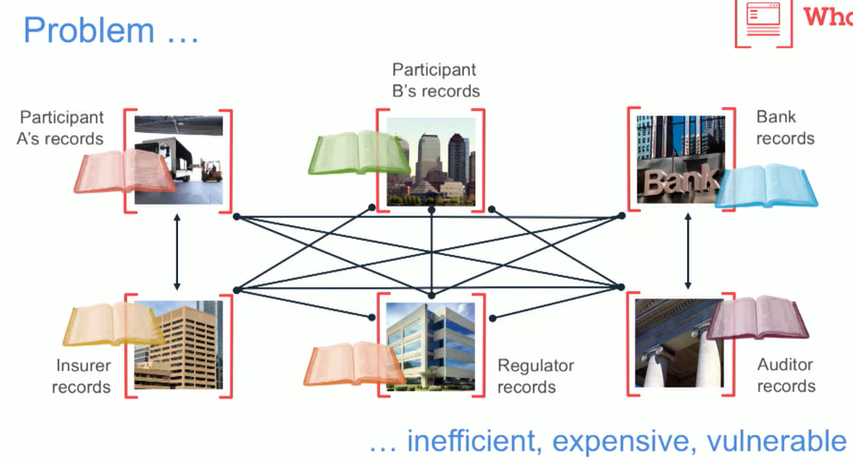
Blockchain |benefits

Slide 26
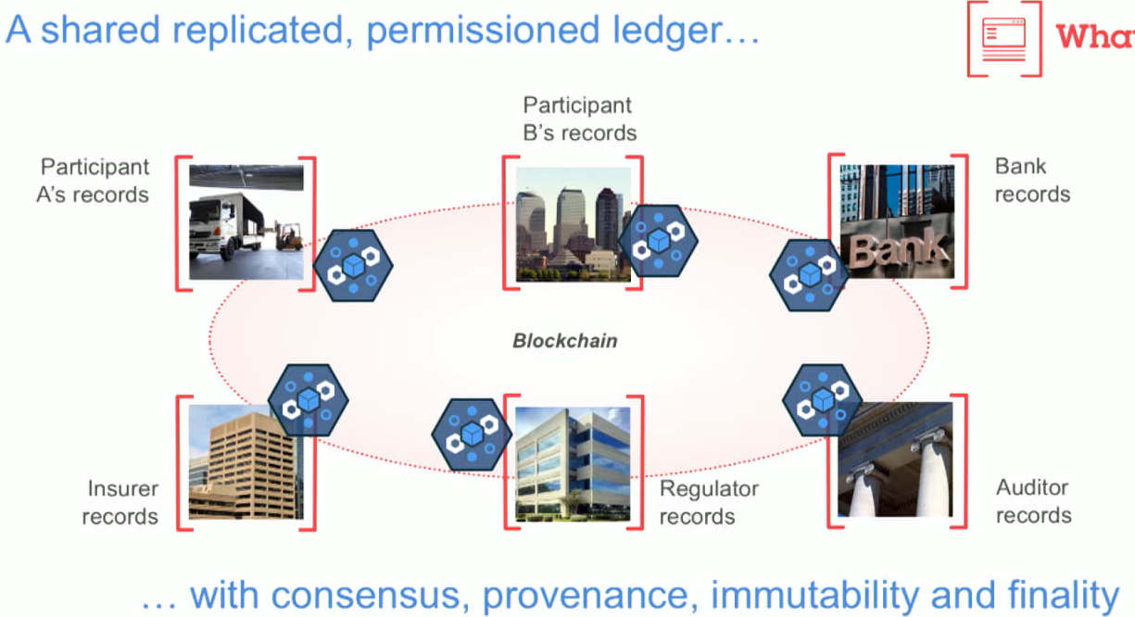
Blockchain |benefits

Slide 27
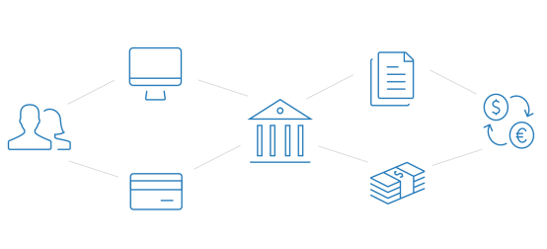
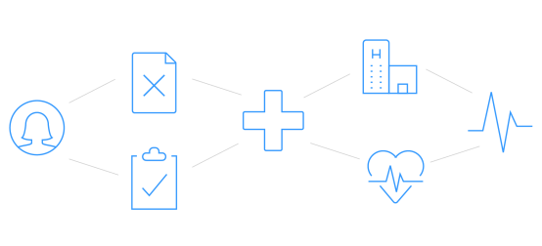
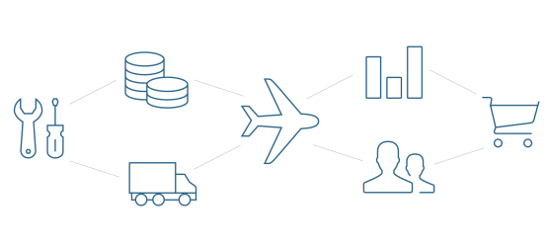
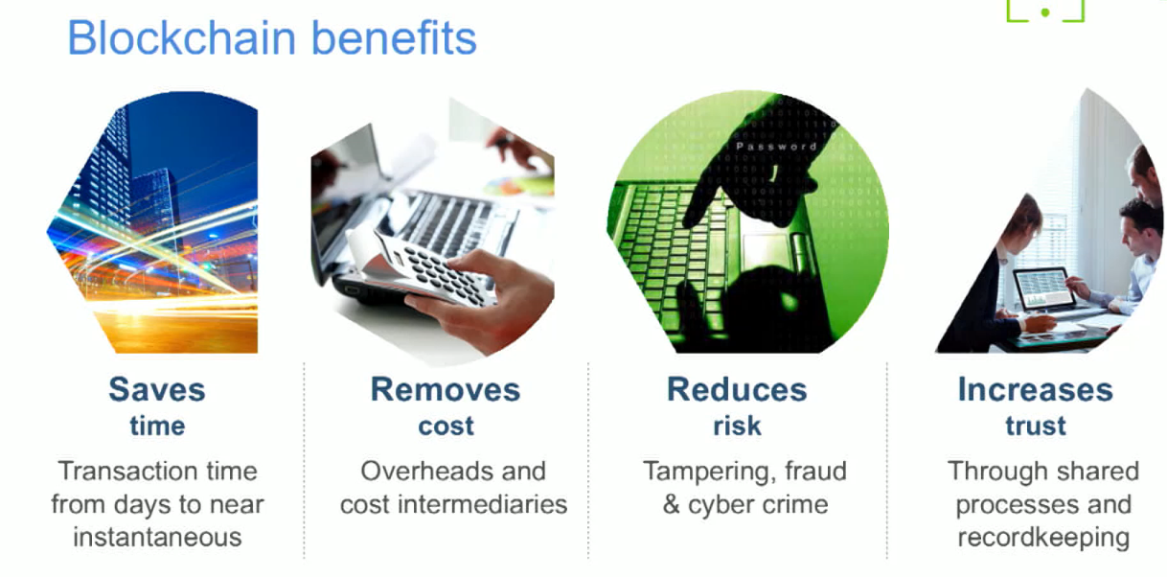
Blockchain |benefits
Blockchain allows multiple different parties to securely interact with the same universal source of truth
Finance
Streamlined settlement, improved liquidity, increased transparency and new products/markets
Healthcare
Unite disparate processes, increase data flow and liquidity, reduce costs and improve patient experience and outcomes
Supply Chain
Track parts and service provenance, ensure authenticity of goods, block counterfeits, reduce conflicts

Slide 28
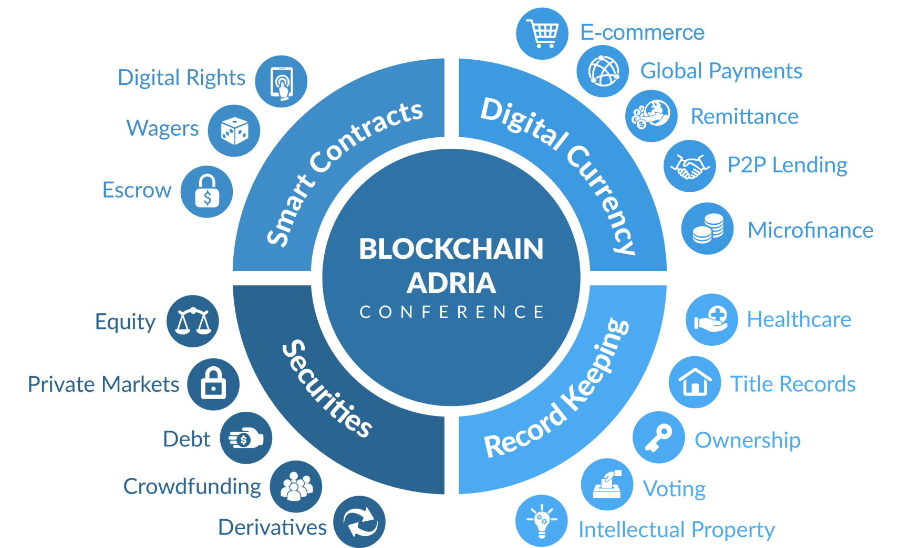
Blockchain |benefits
Blockchain

Slide 29

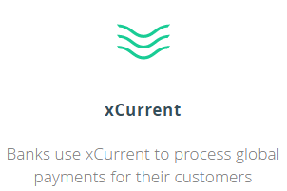
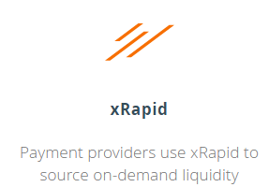
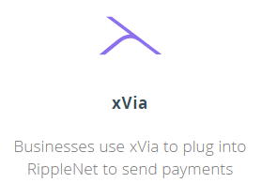
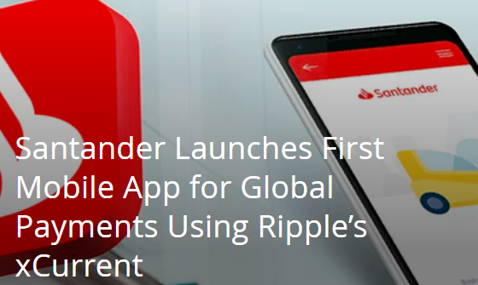




Blockchain |Use Cases |
Ripple has their own digital currency Ripple (XRP). It is the third biggest
cryptocurrency in the world in terms of cryptocurrency market capitalizations.
RippleNet
Ripple connects banks, payment providers, digital asset exchanges and corporates via RippleNet to provide one frictionless experience to send money globally.
ACCESS
Connectivity across payments networks
SPEED
Instant, on-demand settlement
CERTAINTY
Real-time traceability of funds
COST
Low operational and liquidity costs

Slide 30

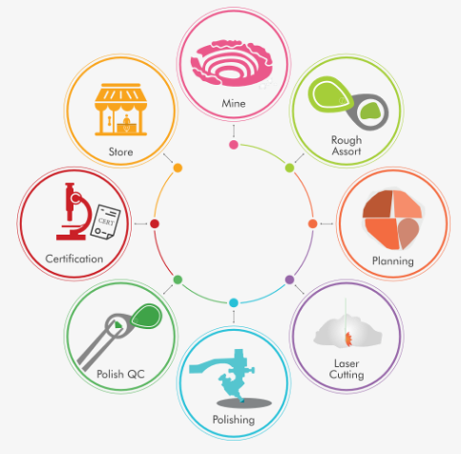
Blockchain |Use Cases |
Everledger is a global startup that uses the best of emerging technology including blockchain, smart contracts and machine vision to assist in the reduction of risk and fraud for banks, insurers and open marketplaces.
Global digital ledger that tracks and protects valuable assets throughout their lifetime journey.
It collects an asset’s defining characteristics, history, and ownership to create a permanent record on the blockchain. This digital incarnation, or thumbprint, is used by various stakeholders across a supply chain pipeline to form provenance and verify authenticity.

Slide 31


Blockchain |Use Cases |
Launched in July 4, 2016, Steemit is a blogging and social networking website that uses its Steem blockchain-based rewards platform for publishers. The Steem blockchain produces Steem and Steem Dollars which are magic bean tokens obtained for posting, discovering, and commenting on content.
Steem is based on the Smart Media Tokens (SMT) protocol, developed by Steemit.
User accounts can upvote posts and comments similar to other blogging websites or social news websites like Reddit, and the authors who get upvoted can receive a monetary reward in a cryptocurrency token named Steem and US dollar-pegged tokens called Steem Dollars

Slide 32
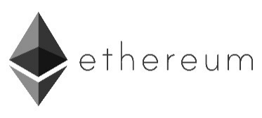
Blockchain | Development platform |
At its simplest, Ethereum is an open software platform based on blockchain technology that enables developers to build and deploy decentralized applications.
Ethereum is a decentralized platform that runs smart contracts: applications that run exactly as programmed without any possibility of downtime, censorship, fraud or third-party interference.
Like Bitcoin, Ethereum is a distributed public blockchain network. Although there are some significant technical differences between the two, the most important distinction to note is that Bitcoin and Ethereum differ substantially in purpose and capability. Bitcoin offers one particular application of blockchain technology, a peer to peer electronic cash system that enables online Bitcoin payments. While the Bitcoin blockchain is used to track ownership of digital currency (bitcoins), the Ethereum blockchain focuses on running the programming code of any decentralized application.
https://ropsten.etherscan.io/

Slide 33






Blockchain | Development platform |
Hyperledger is an open source collaborative effort created to advance cross-industry blockchain technologies. It is a global collaboration, hosted by The Linux Foundation, including leaders in finance, banking, Internet of Things, supply chains, manufacturing and Technology.
Only an Open Source, collaborative software development approach can ensure the transparency, longevity, interoperability and support required to bring blockchain technologies forward to mainstream commercial adoption. That is what Hyperledger is about – communities of software developers building blockchain frameworks and platforms.
Create enterprise grade, open source, distributed ledger frameworks and code bases to support business transactions
Provide neutral, open, and community-driven infrastructure supported by technical and business governance
Build technical communities to develop blockchain and shared ledger POCs, use cases, field trails and deployments
Educate the public about the market opportunity for blockchain technology
Promote our community of communities taking a toolkit approach with many platforms and frameworks

Slide 34
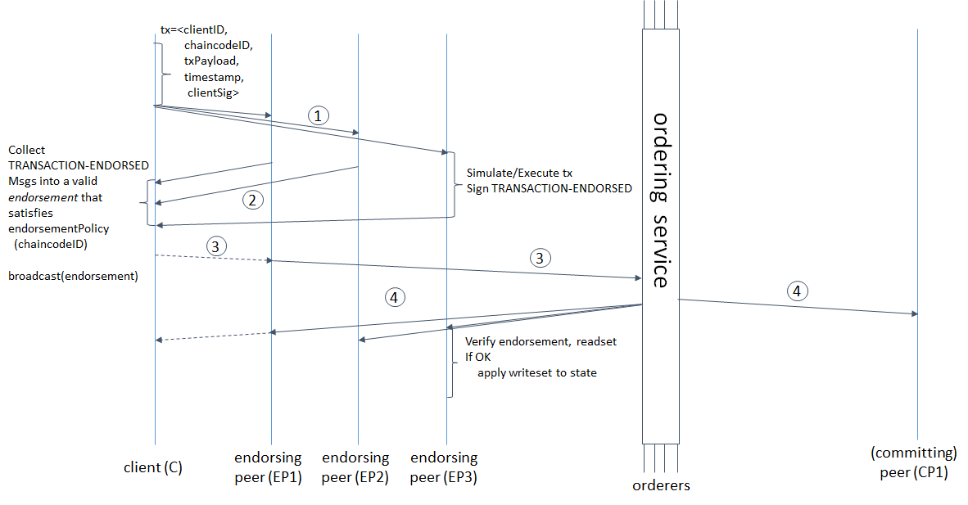
Blockchain | Development platform |
Illustration of one possible transaction flow (common-case path)
1. The client creates a transaction and sends it to endorsing peers of its choice
2. The endorsing peer simulates a transaction and produces an endorsement signature
3. The submitting client collects an endorsement for a transaction and broadcasts it through ordering service
4. The ordering service delivers a transactions to the peers

Slide 35
Blockchain |Development platform |

Slide 36
Blockchain |facts
The first blockchain was conceptualized by a person (or group of people) known as Satoshi Nakamoto in 2008.
In August 2014, the bitcoin blockchain file size, containing records of all transactions that have occurred on the network, reached 20 GB. In January 2015, it had grown to almost 30 GB, and from January 2016 to January 2017, it grew from 50 GB to 100 GB in size.
Cryptocurrencies: 2099 / Markets: 14936
Market Cap: $210,967,282,283
24h Vol: $11,875,038,879
BTC Dominance: 53.8%
Only 21 million bitcoins will ever exist

Slide 37
Blockchain |References
Whitepaper by Satoshi Nakamoto- “Bitcoin: A Peer-to-Peer Electronic Cash System” https://bitcoin.org/bitcoin.pdf
Bitcoin Developer Guide - https://bitcoin.org/en/developer-guide#block-chain-overview
Smart Contracts - https://blockgeeks.com/guides/smart-contracts/
Introduction to Blockchain for Technical Executives - https://academy.b9lab.com/
https://en.bitcoin.it/wiki/Main_Page
https://Blockchain.info
https://www.hyperledger.org/
https://www.slideshare.net/Blockstrap
https://cognitiveclass.ai/badges/blockchain-essentials/
https://training.linuxfoundation.org/portal
https://coinmarketcap.com/all/views/all/
https://masterthecrypto.com/differences-between-cryptocurrency-coins-and-tokens/
https://en.bitcoin.it/wiki/Irreversible_Transactions

